Slide 1


SRI SHANMUGHA COLLEGE OF ENGINEERING AND TECHNOLOGY Department of Biomedical Engineering
Present by,
Chanthruba C
Sindhu M
Srimathi T
Swetha S

Slide 2
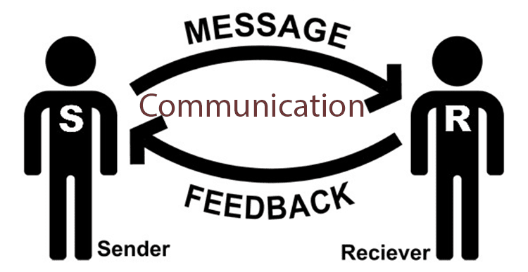
Communication…
Communication is the process of transmitting information, ideas, thoughts, or feelings from one person or entity to another. It involves the exchange of messages using various methods such as spoken or written language, body language, gestures, symbols, and technology.
Clear and effective communication is vital for building relationships, resolving conflicts, conveying information, and achieving common goals.

Slide 3
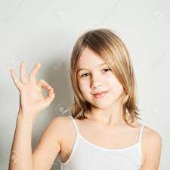


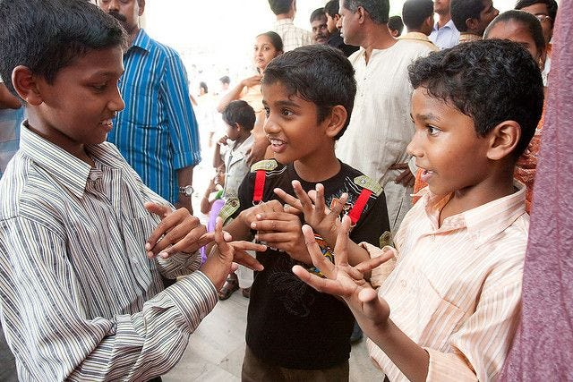
Please guess what they are trying to say?

Slide 4

Sign language…
Sign language is a manual communication used especially by people who cannot hear or speak, using the hands to make signs instead of spoken words.
Sign language is not universal; people who are deaf from different countries speak different sign languages.
It is not easily understand by the normal people.

Slide 5
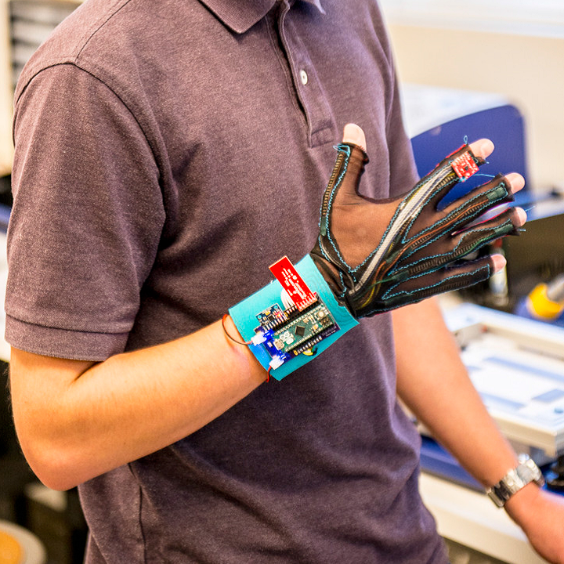
Smart Gloves for Deaf and Dumb

Slide 6

What is an iot?

Slide 7

Outline…
Problem statement and motivation
Block diagram
Requirements
Working
Conclusion
Future work

Slide 8
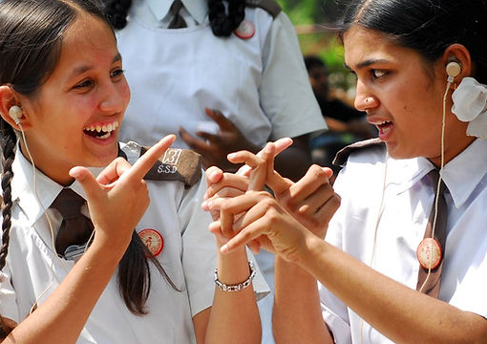
Problem statement…
The special persons face difficulty in communication with normal person. Because of this, a person who lacks in hearing and speaking ability is not able to stand in race with normal person.
Motivation....
The main motivation of the project is to reduce communication barrier between normal people and special person who are not able to make a normal conversation be it a disabled one or deaf and dumb.

Slide 9
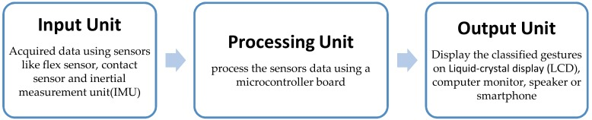
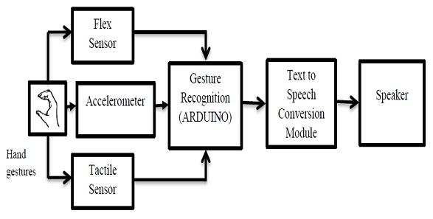
Block diagram…

Slide 10
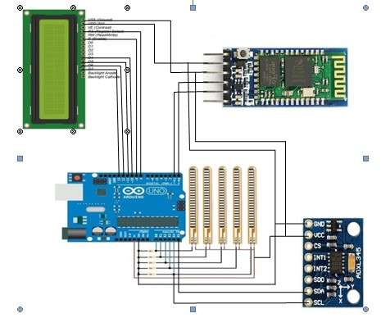
Requirements…

Slide 11
Working….

Slide 12
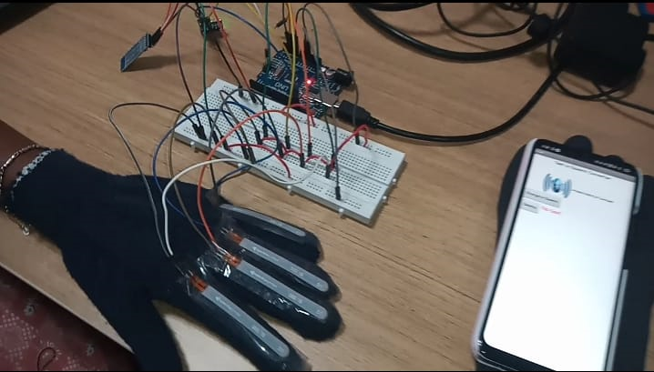
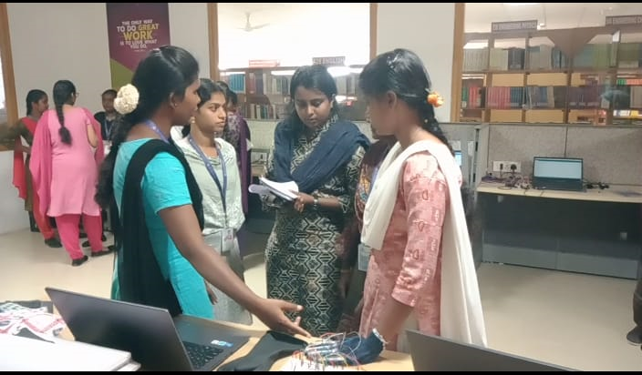
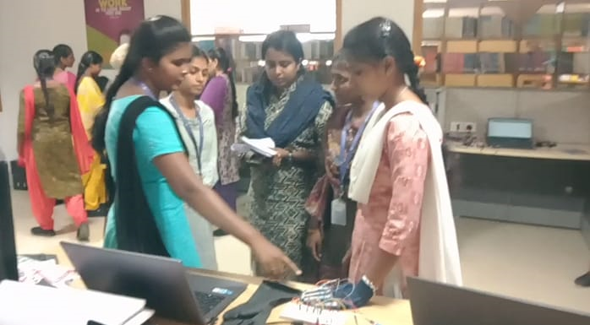
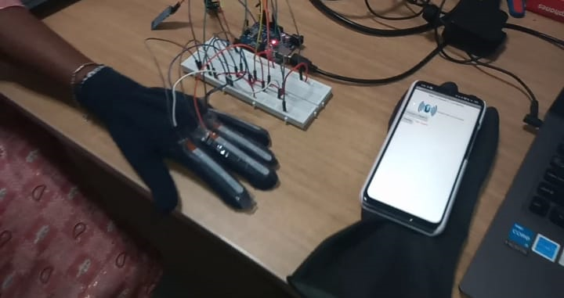
IMPLEMENTATION:

Slide 13
Conclusion…

Slide 14
Future work…

Slide 15
THANK YOU!

